Slide 1

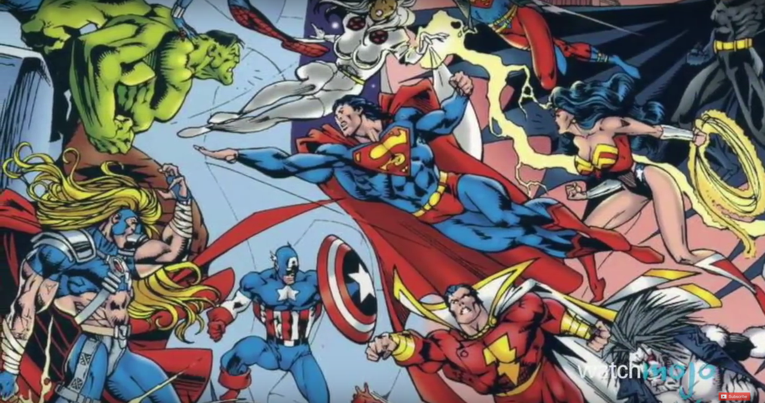
Superhero's
Alan, Heather, Jarvis
(Team Awesome)

Slide 2

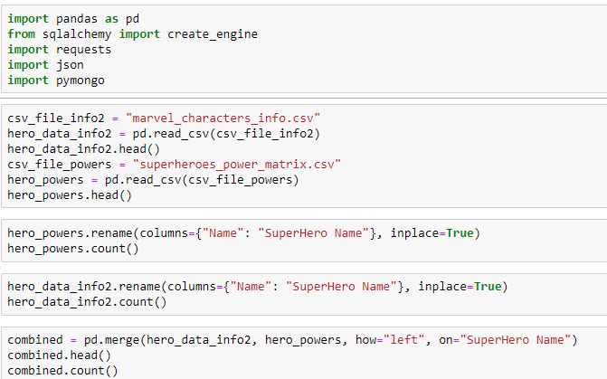

Back to Basics
Bring in our basics and then leverage Pandas to bring in some CSV data.
Combine the csv data sets using Super Hero Name and Name as a join and remaining them to the same field header.
Once we combined the csv data sets by leveraging name as the key, we where able to create one data frame with all the super hero data from both csv files into one view.

Slide 3

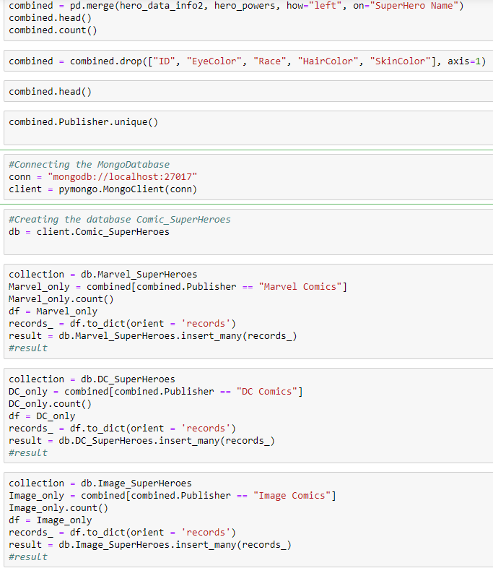
Modifications
After combining the data we did some general counts on the total rows of data and then began to remove several fields we didn’t need.
The team then connected to MongoDB local host to allow us to send our collection segments to our Mongo DB.
We decided to filter the data by the Publisher Field. This helped us create 5 different collections of data around our different super heroes and their powers.

Slide 4





